Slide 1

What is Java ?
1
Programming Language
Instructions for computers to execute
Platform
Java has its own runtime environment (JRE)

Slide 2
Use of Java ?
2
Web Development
Enterprise Applications
Desktop Applications
Embedded Systems
Mobile Apps

Slide 3
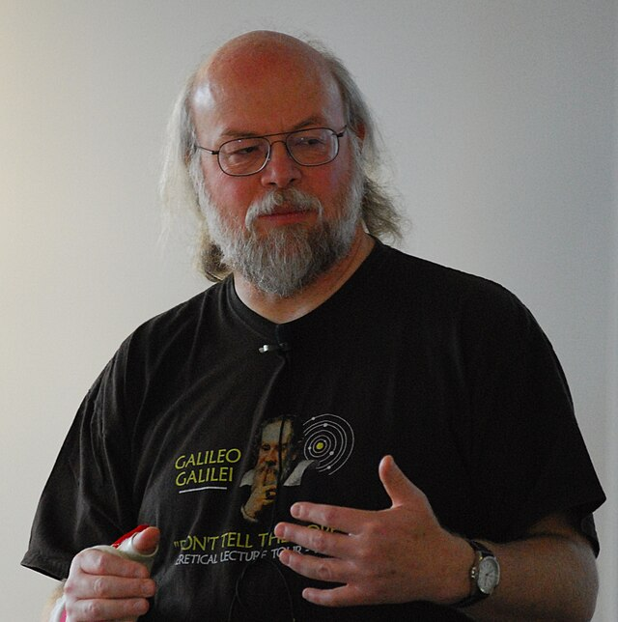
History of Java ?
3
Developer | James Gosling & his team
Company | Sun Microsystems (now acquired by Oracle in Jannuary 27, 2010)
Year | 1995 : Alpha & Beta (testing version) 1996 : JDK 1.0 (First stable version) 2024 : Java SE 23 (latest version)
First Name | Oak now change to java because of already Trademark by Oak Technologies
James Gosling

Slide 4
4
Features of Java
Object Oriented
Portable
Secured
Robust
Platform Independent

